Slide 1
Introduction to Future Technology Transformations FTT(3)
Pim Vercoulen ピムバクレン
p.vercoulen@student.ru.nl
June 30th, 2018 ASSIA office Nagoya University 名古屋大学

Slide 2
Background
Framework developed by Jean-François Mercure (currently professor at Radboud University, Nijmegen, The Netherlands).
FTT:Power (2012, Jean-François Mercure)
FTT:Transport (2015, Aileen Lam)
FTT:Heat (2017, Florian Knobloch)
FTT:Steel (~2018, Lorena van Duuren & Pim Vercoulen)
FTT:Agriculture (~2018, Sören Linder)
FTT:Cement (t.b.a.)
Together these sectors account for the majority of all emissions!

Slide 3
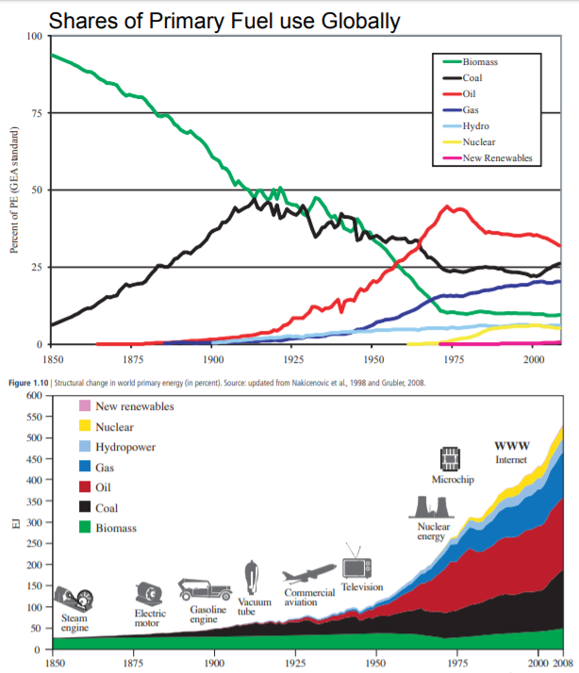
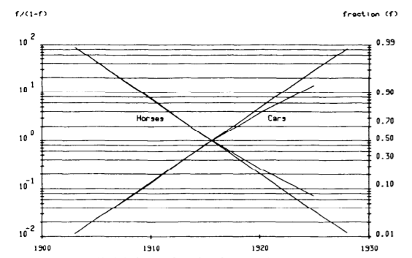
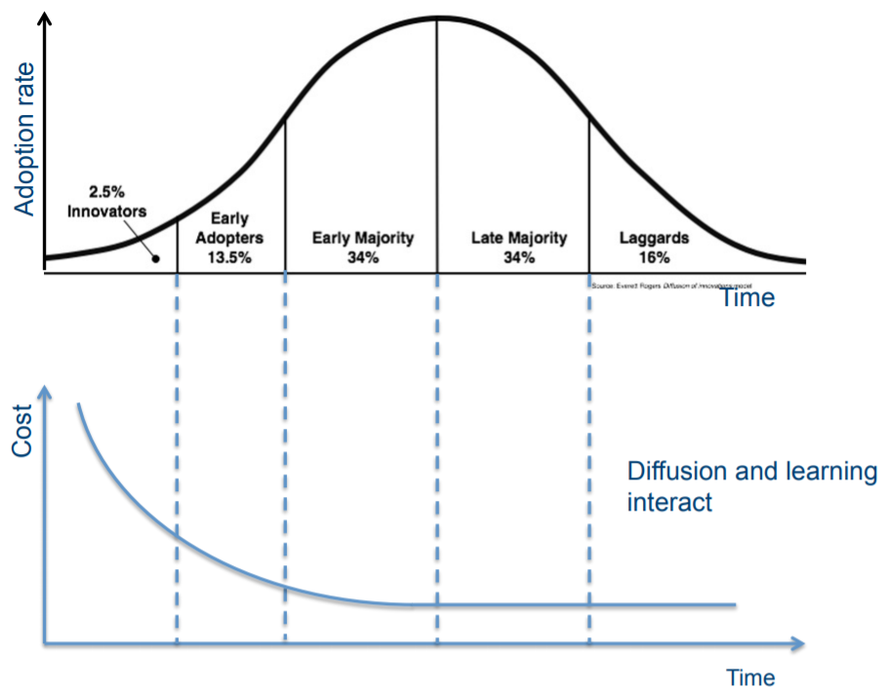
Innovation economics
FTT framework is based on innovation economics (=Schumpeter economics)
Learning rate
S-curve
Why innovation economics:
“Firstly, it is the application of technology that has caused the anthropogenic contribution to climate change in the historical context; both coal and oil were part of processes of transformations of economies and societies. Understanding the history of technology then helps us to direct the course of future technical change. Secondly, a change to a low carbon society will require widespread development and mass deployment of new, low carbon technologies”
(Köhler, et al. 2006)
The bottom-up schumpeter approach works well with the top-down post-Keynesian approach
Global Energy Assessment Ch1 Energy Primer p113 (2012)
Nakicenovic, Technology Forecasting and Social Change (1986)
E.M. Rogers, Diffusion of Innovations, Fifth Edition p281 (2010)

Slide 4
General FTT Methodology – Levelized Cost
Price of commodity based on Levelised Cost calculation
$$NPVexpenses=\sum_{0}^{τ}{\frac{IC\left(t\right)+OM\left(t\right)+FC\left(t\right)+CO2T\left(t\right)+…}{{\left(1+r\right)}^{t}}}$$
${NPV}_{income}=$ $\sum_{0}^{τ}{\frac{P\left(t\right)∗Production(t)}{{\left(1+r\right)}^{t}}}=P∗\sum_{0}^{τ}{\frac{1}{{\left(1+r\right)}^{t}}}$
$$Break−even:\frac{{NPV}_{expenses}}{{NPV}_{income}}=\frac{\sum_{0}^{τ}{\frac{IC\left(t\right)+OM\left(t\right)+FC\left(t\right)+CO2T\left(t\right)+…}{{\left(1+r\right)}^{t}}}}{P∗\sum_{0}^{τ}{\frac{1}{{\left(1+r\right)}^{t}}}}=1$$
$LC\left(t\right)=P=$ $\frac{\sum_{0}^{τ}{\frac{IC\left(t\right)+OM\left(t\right)+FC\left(t\right)+CO2T\left(t\right)+…}{{\left(1+r\right)}^{t}}}}{\sum_{0}^{τ}{\frac{1}{{\left(1+r\right)}^{t}}}}$
$$sdLC=\frac{\sum_{0}^{τ}{\frac{\sqrt{{\left({sdIC}/{CF}\right)}^{2}+{sdOM}^{2}+{sdFC}^{2}+…}}{{\left(1+r\right)}^{t}}}}{\sum_{0}^{τ}{\frac{1}{{\left(1+r\right)}^{t}}}}$$
Costs are not perfectly defined since there are regional variances that can affect the costs as experienced by the investor

Slide 5
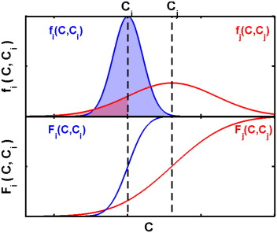
General FTT Methodology – Preference Matrix
Preference matrix
Probility of an investor chosing for technology i or j
Standard deviation of preference (dF_{ij})
${dF }_{ij}=\sqrt{2∗sd{{LC}_{i}}^{2}\text{∗} {{sdLC}_{j}}^{2}}$
Preference F_{A->B}
$F_{i→j}=\frac{1}{2}+\frac{1}{2}∗\frac{2}{\sqrt{π}}\int{e^{{−\left(\frac{{LCOS}_{j}−{LCOS}_{i}}{{sdF}_{ij}}\right)}^{2}}}$
$F_{j→i}={1−F}_{j→i}$

Slide 6
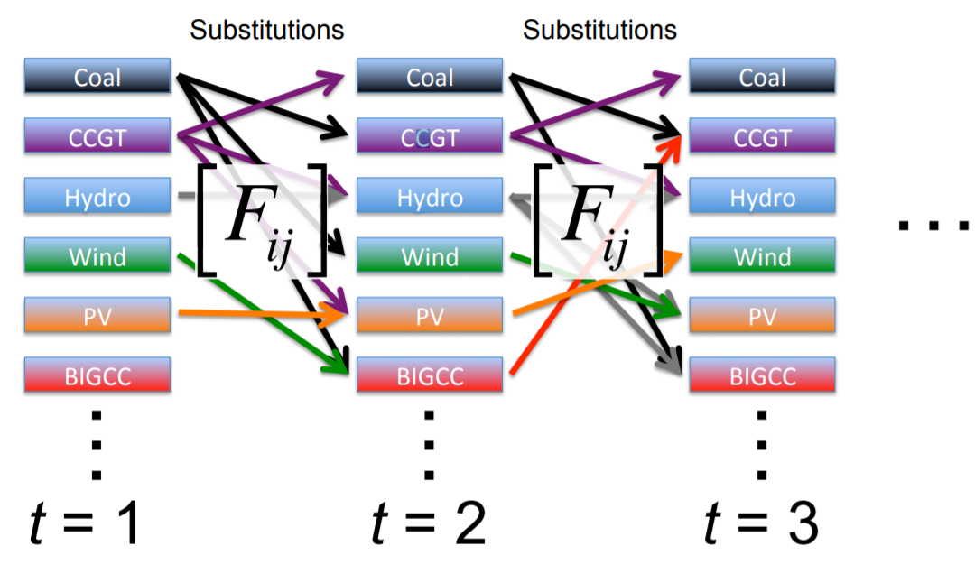
General FTT Methodology – Share changes
As a result of the LC, we get investor preferences (F_{ij}), and as a result of investor preferences we get market share changes (ΔS_{i->j})
$$∆S_{j→i}∝ \frac{S_{i}}{{BT}_{i}}∙\frac{S_{j}}{{LT}_{j}}∙F_{ij}∙∆t$$
$$∆S_{i→j}∝ \frac{S_{j}}{{BT}_{j}}∙\frac{S_{i}}{{LT}_{i}}∙F_{ji}∙∆t$$
$$\sum_{j}{∆S_{j→i}}={∆S}_{i}=\sum_{j}{S_{i}S_{j}∙\left(F_{ij}A_{ij}−F_{ji}A_{ji}\right)∙∆t}$$
$$A_{ij}= \frac{κ}{{BT}_{i}∙{LT}_{j}}$$
Technological Lock-in
Cost-based preference of investors
$$\sum_{j}{∆S_{j→i}}={∆S}_{i}=\sum_{j}{S_{i}S_{j}∙\left(F_{ij}A_{ij}−F_{ji}A_{ji}\right)∙∆t}$$
Constraint of substitution rate

Slide 7
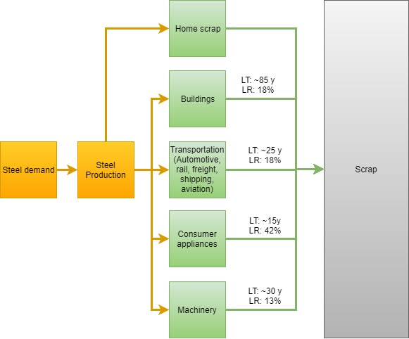
FTT:Steel – Scrap Availability
Scrap availability is proportional to steel stocks within different sectors
…but steel becomes available as scrap after the EOL
…and different sectors use different steel qualities and coatings which could render it unsuitable as steel scrap

Slide 8
FTT:Steel – Variable material input
Input-Output !
Identity matrix IO-table Final demand vector
$$Inventory={\left(\left(\begin{matrix}1 & ⋯ & 0 \\ ⋮ & ⋱ & ⋮ \\ 0 & ⋯ & 1\end{matrix}\right)−\left(\begin{matrix}X_{11} & ⋯ & X_{1n} \\ ⋮ & ⋱ & ⋮ \\ X_{n1} & ⋯ & X_{nn}\end{matrix}\right)\right)}^{−1}∗\left(\begin{matrix}1 \\ ⋮ \\ 0\end{matrix}\right)$$

Slide 9
Coal quality can affect the amount of coal and coke consumed
Iron ore quality (i.e. iron content) affects the amount of iron ore consumed
Scrap is usually co-melted for quality insurance and to suppress costs
…but scrap is not always available
…but scrap quality can vary (even to the point where it is rendered useless
How does FTT:Steel calculate material consumption for each time iteration?

Slide 10
 | Steelmaking technology | Ironmaking technoloy | Intermediate plants (coke plant, sinter plant, pellet plant) |  |  | Raw materials
 | Steel | Iron | Coke | Sinter | Pellets | Scrap | Coal | Natural Gas | Electricity | Iron ore | Limestone | Hydrogen | Biomass
Steel | … | … | … | … | … | … | … | … | … | … | … | … | …
Iron | … | … | … | … | … | … | … | … | … | … | … | … | …
Coke | … | … | … | … | … | … | … | … | … | … | … | … | …
Sinter | … | … | … | … | … | … | … | … | … | … | … | … | …
Pellets | … | … | … | … | … | … | … | … | … | … | … | … | …
Scrap | … | … | … | … | … | … | … | … | … | … | … | … | …
Coal | … | … | … | … | … | … | … | … | … | … | … | … | …
Natural Gas | … | … | … | … | … | … | … | … | … | … | … | … | …
Electricity | … | … | … | … | … | … | … | … | … | … | … | … | …
Iron ore | … | … | … | … | … | … | … | … | … | … | … | … | …
Limestone | … | … | … | … | … | … | … | … | … | … | … | … | …
Hydrogen | … | … | … | … | … | … | … | … | … | … | … | … | …
Biomass | … | … | … | … | … | … | … | … | … | … | … | … | …

Slide 11
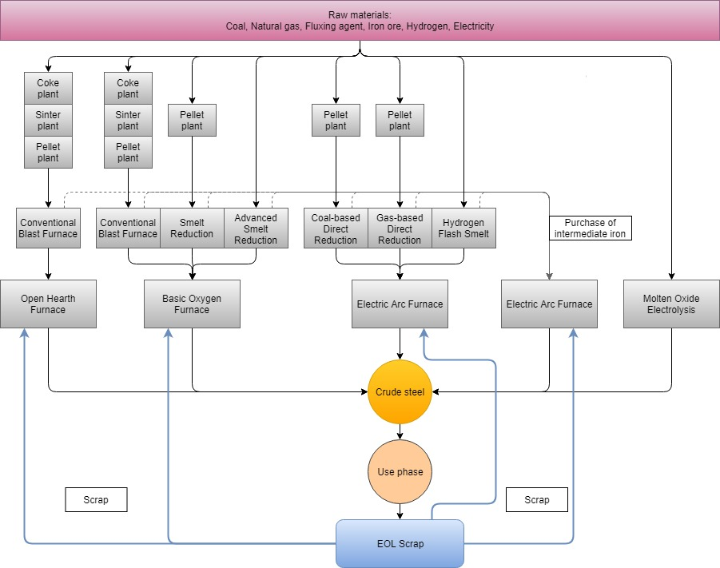
Integrated Iron and Steelmaking routes

Slide 12
FTT:Steel – 26 technologies
Ironmaking |  | Steelmaking |  | Integrated route | Variations
Conventional Blast Furnace | + | Open Hearth Furnace | = | Conv. BF – OHF | Only fossil
Conventional Blast Furnace | + | Basic Oxygen Furnace | = | Conv. BF – BOF | Fossil Biomass Carbon Capture and Storage (CCS) Biomass + CCS
Blast Furnace Top Gas Recovery | + | Basic Oxygen Furnace | = | BF TGR – BOF | CCS Biomass + CCS
Gas-based Direct Reduction | + | Electric Arc Furnace | = | DRI-gas – EAF | Fossil Biomass CCS Biomass + CCS
Coal-based Direct Reduction | + | Electric Arc Furnace | = | DRI-coal – EAF | Fossil Biomass CCS Biomass + CCS
Smelt Reduction | + | Basic Oxygen Furnace | = | SRI – BOF | Fossil Biomass CCS Biomass + CCS
Advanced Smelt Reduction | + | Basic Oxygen Furnace | = | SRI+ - BOF | Fossil Biomass CCS Biomass + CCS
Hydrogen Flash Smelt | + | Electric Arc Furnace | = | HFS – EAF | No variations
- | + | Molten Oxide Electrolysis | = | MOE | No variations
- | + | Electric Arc Furnace | = | Scrap – EAF | No variations

Slide 13
FTT:Steel – Data acquisition (work-in-progress)
Historical steel production is recorded by the World Steel Association (~1970-2017)
…but does not contain the resolution needed for this study
Historical emissions from the iron and steel industry are recorded by the Joint Research Centre of the European Commission (EC-JRC) (1970-2012)
…but only total emissions and not on technology-specific level
Material use was gathered from multiple sources and these show great variations
In different regions different material qualities are available
E.g. in Chinese reserves of iron ore and coal are usually of lower quality and therefore consume greater quantities
Material use over time changed, i.e. efficiency increased
…but no good source of historical material use was found

Slide 14
FTT:Steel – Data acquisition (work-in-progress)
Technology specific cost aspects varied accross sources
Investment costs of existing technologies were mainly obtained from IEA-ETSAP and IETD-IIP
Not on a regional basis due to limitation of sources and due to the assumption that it would vary little among countries since only a few engineering companies are available of steel plant construction
Operation and maintenance was made variable along with material consumption
Technological specifications of novel technologies
Based on scientific papers that serve as a proof of concept of technology, but how are costs estimated?

Slide 15
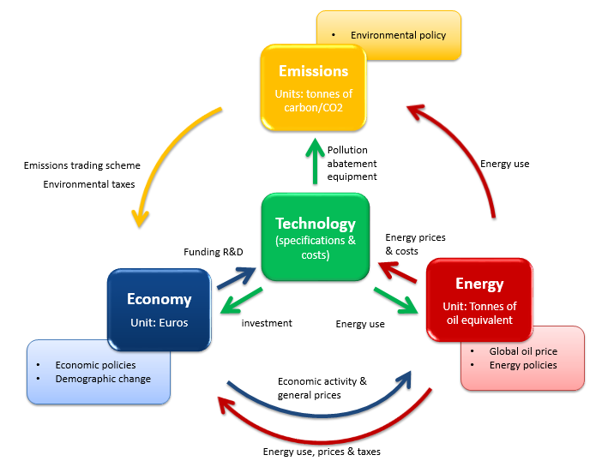
FTT-E3ME feedbacks
Post-Schumpeterian
(evolutionary)
FTT
・Fuel/Material consumption
・Investment in
new production technology
・product price
・product demand
・Fuel/Material demand
E3ME
Post-Keynesian
＝

Slide 16
FTT:Steel – Overall structure after coupling to E3ME

